Slide 1
Motion Control (kinematic control)
Reza Ghabcheloo
IHA 4306 Moro

Slide 2
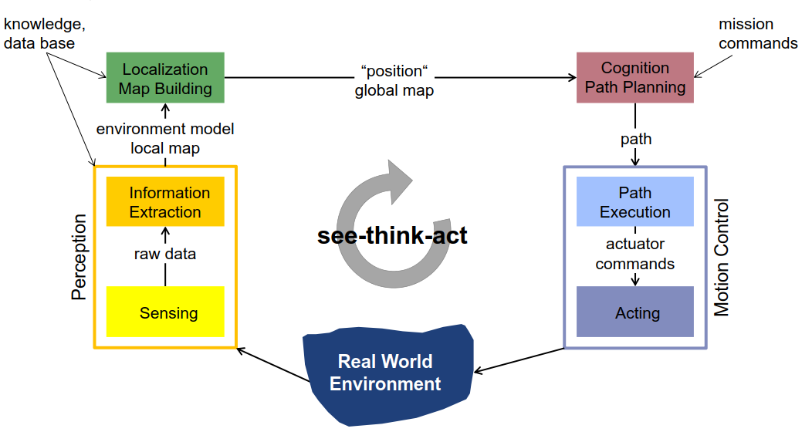
See Think Act control architecture

Slide 3
Robot motion control
Trajectory tracking
Path following
Starting from 1D robot!
From now on, I will drop the frames for clarity of presentation. They will become important when actually implementing these controllers

Slide 4
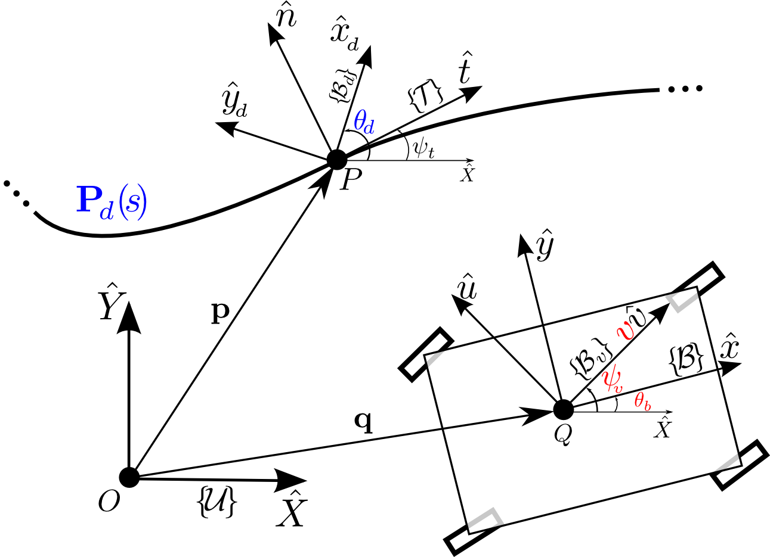
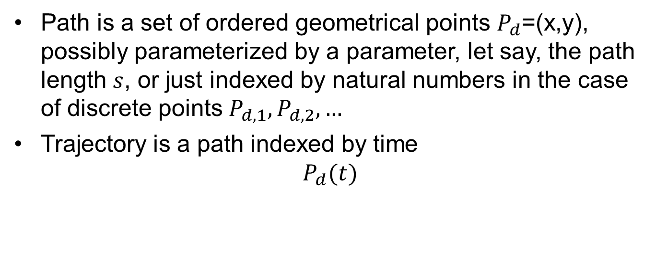
Definitions
Path is a set of ordered geometrical points $P_{d}$=(x,y), possibly parameterized by a parameter, let say, the path length $s$, or just indexed by natural numbers in the case of discrete points $P_{d,1},P_{d,2},…$
Trajectory is a path indexed by time
$$P_{d}(t)$$

Slide 5
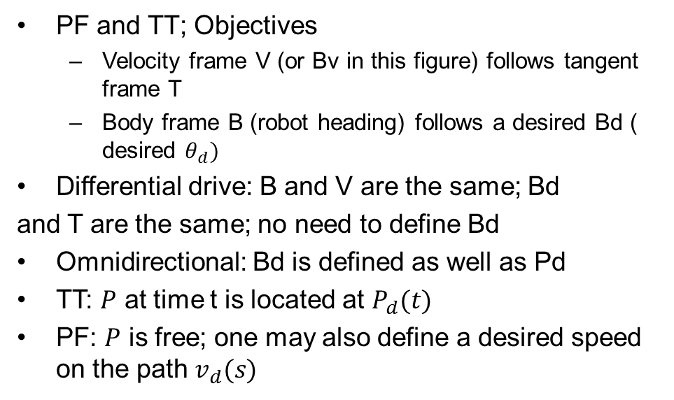
Definitions
PF and TT; Objectives
Velocity frame V (or Bv in this figure) follows tangent frame T
Body frame B (robot heading) follows a desired Bd ( desired $θ_{d})$
Differential drive: B and V are the same; Bd
and T are the same; no need to define Bd
Omnidirectional: Bd is defined as well as Pd
TT: $P$ at time t is located at $P_{d}(t)$
PF: $P$ is free; one may also define a desired speed on the path $v_{d}(s)$

Slide 6

Path following and Trajectory tracking
Q: Is defining $P_{d}\left(t\right)$ and pair ($P_{d}\left(s\right), v_{d}(s)$) define the same problem?

Slide 7
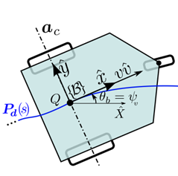
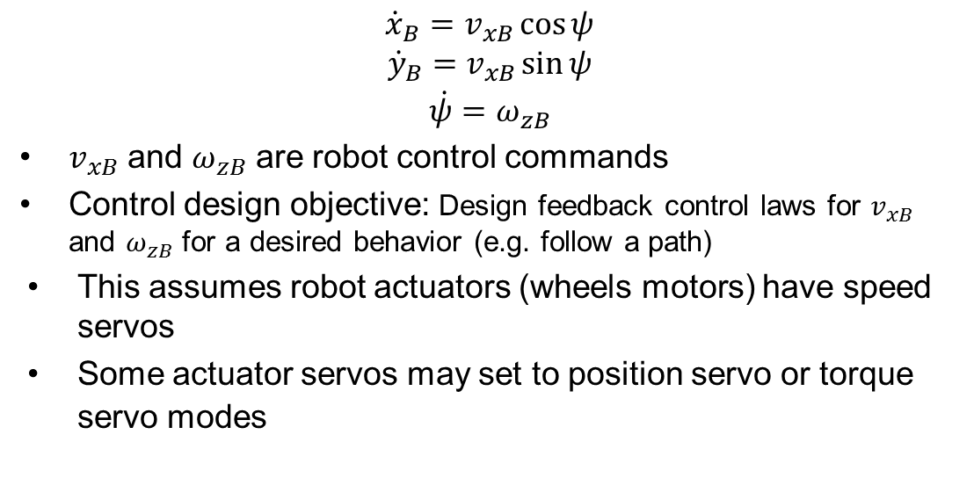
Differential drive kinematics/control
$$\begin{matrix}{\dot{x}}_{B}=v_{xB}\cos{ψ} \\ \begin{aligned}{\dot{y}}_{B}=v_{xB}\sin{ψ} \\ \dot{ψ}=ω_{zB}\end{aligned}\end{matrix}$$
$v_{xB}$ and $ω_{zB}$ are robot control commands
Control design objective: Design feedback control laws for $v_{xB}$ and $ω_{zB}$ for a desired behavior (e.g. follow a path)
This assumes robot actuators (wheels motors) have speed servos
Some actuator servos may set to position servo or torque servo modes

Slide 8
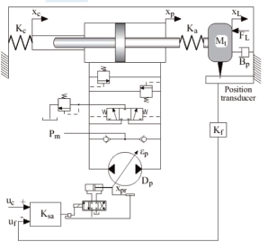
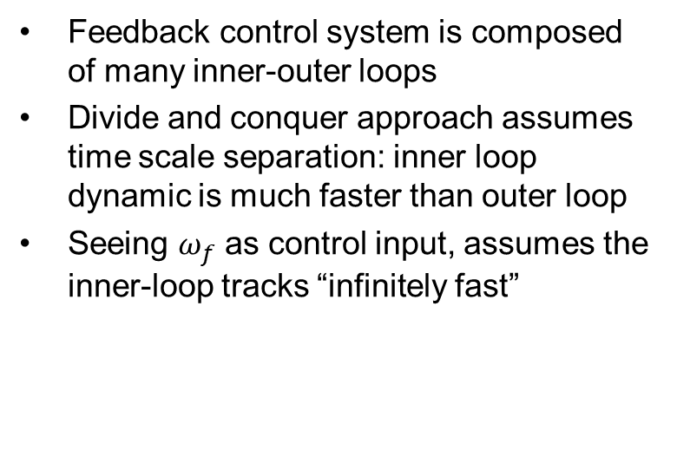
Inner outer loop time scale separation
Feedback control system is composed of many inner-outer loops
Divide and conquer approach assumes time scale separation: inner loop dynamic is much faster than outer loop
Seeing $ω_{f}$ as control input, assumes the inner-loop tracks “infinitely fast”
This hyd circuit is not for steering, just an example
…xL ref
ep ref
sp
P2
ep
P1
xL
+
C1
+
C2

Slide 9
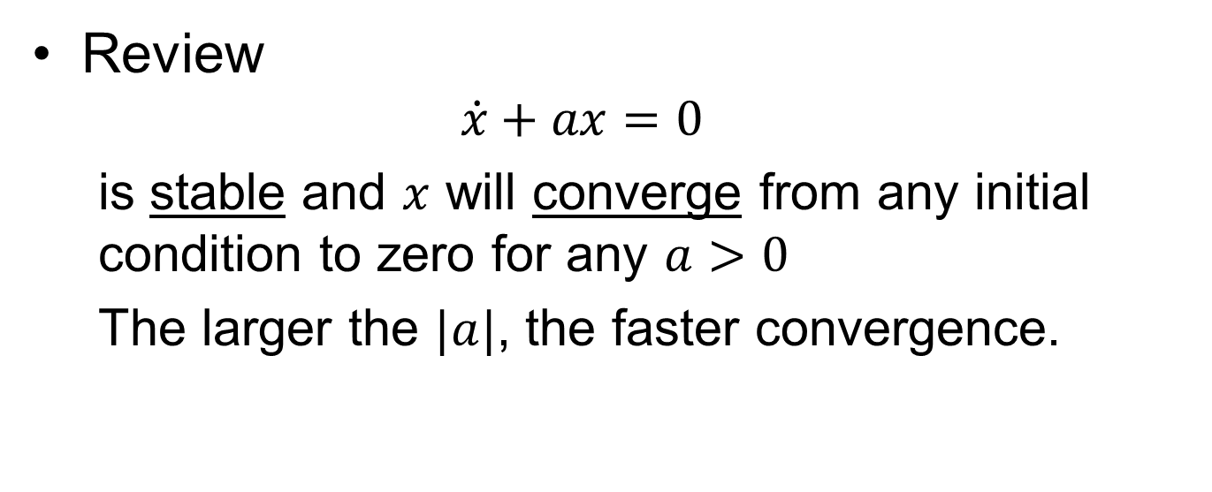
Dynamic systems
Review
$$\dot{x}+ax=0$$
is stable and $x$ will converge from any initial condition to zero for any $a>0$
The larger the $|a|$, the faster convergence.

Slide 10
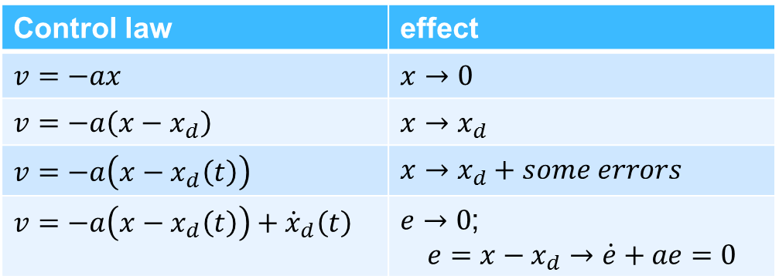

1D robot tracking controller
Robot dynamics: $\dot{x}=v$, where $x$ robot position, $v$ robot velocity
Control law | effect
$v=−ax$ | $x→0$
$v=−a\left(x−x_{d}\right)$ | $x→x_{d}$
$v=−a\left(x−x_{d}\left(t\right)\right)$ | $x→x_{d}+some errors$
$v=−a\left(x−x_{d}\left(t\right)\right)+{\dot{x}}_{d}\left(t\right)$ | $e→0$; $$e=x−x_{d}→\dot{e}+ae=0$$
feedback
feedfroward

Slide 11



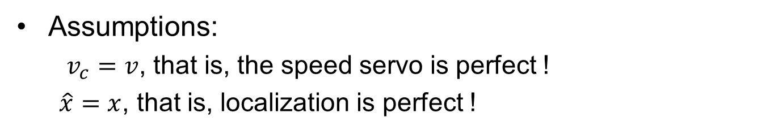

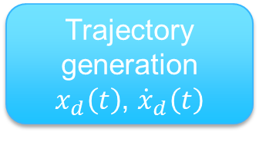


Implementation
A real robot has speed & acceleration limits
real time or clock
Trajectory generation
$x_{d}\left(t\right)$, ${\dot{x}}_{d}\left(t\right)$
${\dot{x}}_{d}\left(t\right)$ feedforward
$$x_{d}\left(t\right)$$
Feedback
$$−a\left(x−x_{d}\left(t\right)\right)$$
$$v_{c}$$
+
Robot
$$\dot{x}=v$$
Localization $\hat{x}$
feedback
Assumptions:
$v_{c}=v$, that is, the speed servo is perfect !
$\hat{x}=x$, that is, localization is perfect !

Slide 12
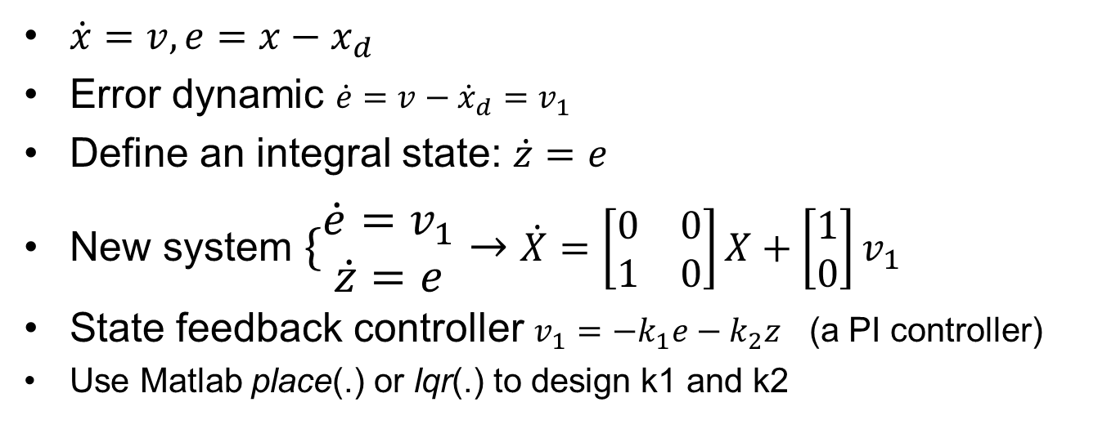
Controller with integrator
$\dot{x}=v, e=x−x_{d}$
Error dynamic $\dot{e}=v−{\dot{x}}_{d}=v_{1}$
Define an integral state: $\dot{z}=e$
New system $\{\begin{matrix}\dot{e}=v_{1} \\ \dot{z}=e\end{matrix}→$ $\dot{X}=\left[\begin{matrix}0 & 0 \\ 1 & 0\end{matrix}\right]X+\left[\begin{matrix}1 \\ 0\end{matrix}\right]v_{1}$
State feedback controller $v_{1}=−k_{1}e−k_{2}z$ (a PI controller)
Use Matlab place(.) or lqr(.) to design k1 and k2

Slide 13



Implementation (integral term)
real time or clock
Trajectory generation
$x_{d}\left(t\right)$, ${\dot{x}}_{d}\left(t\right)$
${\dot{x}}_{d}\left(t\right)$ feedforward
$$x_{d}\left(t\right)$$
$$e=x−x_{d}\left(t\right)$$
$$\dot{z}=e$$
$$v_{1}=−k_{1}e−k_{2}z$$
$$v_{c}$$
$$v_{1}$$
+
Robot
$$\dot{x}=v$$
$$\hat{x}$$
There are always imperfections in the control command (wheel misalignment, servo errors, etc), integral term will remove such constant errors
Q: what about sensor misalignment?

Slide 14
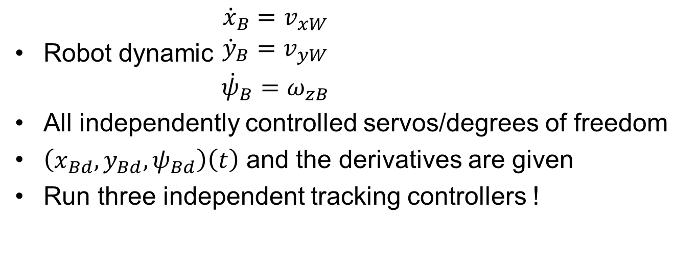
Omni directional robot Trajectory tracking
Robot dynamic $\begin{matrix}{\dot{x}}_{B}=v_{xW} \\ \begin{aligned}{\dot{y}}_{B}=v_{yW} \\ {\dot{ψ}}_{B}=ω_{zB}\end{aligned}\end{matrix}$
All independently controlled servos/degrees of freedom
$\left(x_{Bd},y_{Bd},ψ_{Bd}\right)\left(t\right)$ and the derivatives are given
Run three independent tracking controllers !

Slide 15
Control design and implementation steps
Define the error
Calculate the feedback and feedforward terms
It is the same for steps for differential drive, but far more complex, because of kinematic constraints

Slide 16
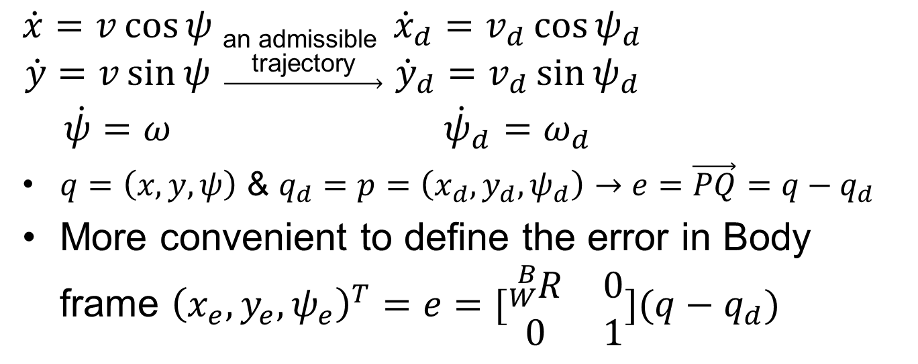
Differential drive, TT
$\begin{matrix}\dot{x}=v\cos{ψ} \\ \dot{y}=v\sin{ψ} \\ \dot{ψ}=ω\end{matrix}$ $\underset{→}{\begin{aligned}\text{a}\text{n} \text{admissible} \\ \text{trajectory}\end{aligned}}$ $\begin{matrix}{\dot{x}}_{d}=v_{d}{\cos{ψ}}_{d} \\ {\dot{y}}_{d}=v_{d}{\sin{ψ}}_{d} \\ {\dot{ψ}}_{d}=ω_{d}\end{matrix}$
$q=\left(x,y,ψ\right)$ & $q_{d}=p=\left(x_{d},y_{d},ψ_{d}\right)→e=\vec{PQ}=q−q_{d}$
More convenient to define the error in Body frame ${\left(x_{e},y_{e},ψ_{e}\right)}^{T}=e=[\begin{matrix}{}_{W}^{B}R & 0 \\ 0 & 1\end{matrix}](q−q_{d})$

Slide 17
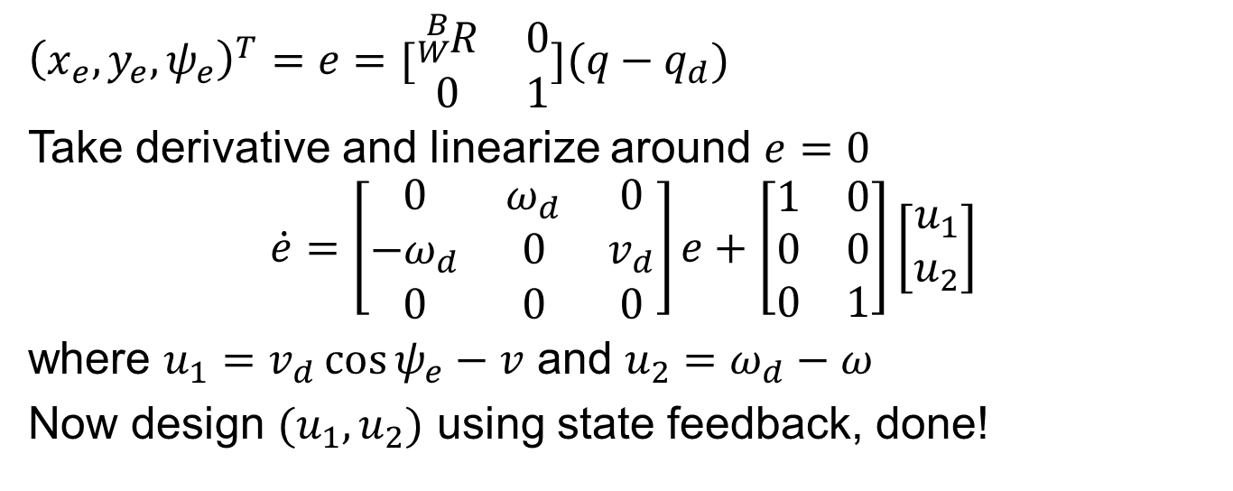
Differential drive, TT
${\left(x_{e},y_{e},ψ_{e}\right)}^{T}=e=[\begin{matrix}{}_{W}^{B}R & 0 \\ 0 & 1\end{matrix}](q−q_{d})$
Take derivative and linearize around $e=0$
$$\dot{e}=\left[\begin{matrix}0 & ω_{d} & 0 \\ −ω_{d} & 0 & v_{d} \\ 0 & 0 & 0\end{matrix}\right]e+\left[\begin{matrix}1 & 0 \\ 0 & 0 \\ 0 & 1\end{matrix}\right]\left[\begin{matrix}u_{1} \\ u_{2}\end{matrix}\right]$$
where $u_{1}=v_{d}\cos{ψ_{e}}−v$ and $u_{2}=ω_{d}−ω$
Now design $(u_{1},u_{2})$ using state feedback, done!

Slide 18
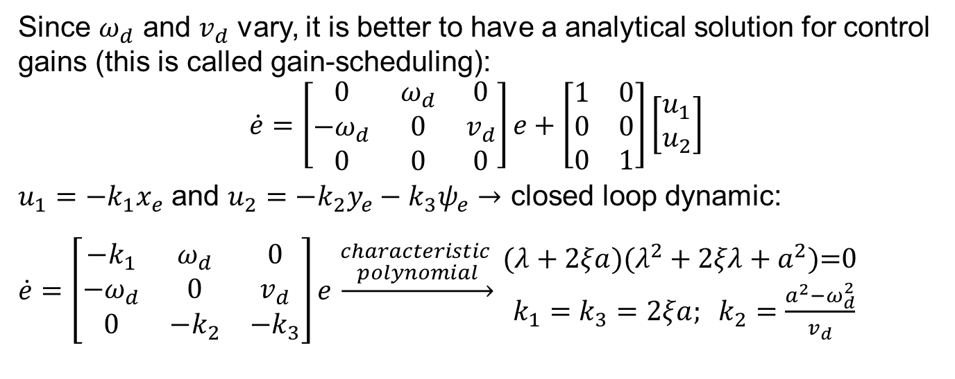
Differential drive, TT
Since $ω_{d}$ and $v_{d}$ vary, it is better to have a analytical solution for control gains (this is called gain-scheduling):
$$\dot{e}=\left[\begin{matrix}0 & ω_{d} & 0 \\ −ω_{d} & 0 & v_{d} \\ 0 & 0 & 0\end{matrix}\right]e+\left[\begin{matrix}1 & 0 \\ 0 & 0 \\ 0 & 1\end{matrix}\right]\left[\begin{matrix}u_{1} \\ u_{2}\end{matrix}\right]$$
$u_{1}=−k_{1}x_{e}$ and $u_{2}=−k_{2}y_{e}−k_{3}ψ_{e}→$ closed loop dynamic:
$\dot{e}=\left[\begin{matrix}−k_{1} & ω_{d} & 0 \\ −ω_{d} & 0 & v_{d} \\ 0 & −k_{2} & −k_{3}\end{matrix}\right]e$ $\underset{→}{\begin{aligned}characteristic \\ polynomial\end{aligned}}$ $\begin{matrix}(λ+2ξa)(λ^{2}+2ξλ+a^{2})\text{=0} \\ k_{1}=k_{3}=2ξa; k_{2}=\frac{a^{2}−ω_{d}^{2}}{v_{d}}\end{matrix}$

Slide 19
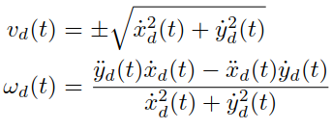
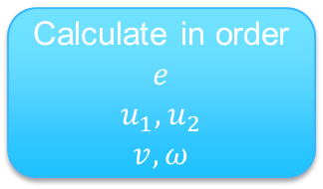





Implementation
Q: Do we have all the ingredients to implement this?
real time or clock
Trajectory generation
$q_{d}\left(t\right)$, ${\dot{q}}_{d}\left(t\right)$
Calculate
$ψ_{d},v_{d},ω_{d}$
Robot
$$\begin{matrix}\dot{x}=v\cos{ψ} \\ \dot{y}=v\sin{ψ} \\ \dot{ψ}=ω\end{matrix}$$
Calculate in order
$$e$$
$$u_{1},u_{2}$$
$$v,ω$$
$$v_{c},ω_{c}$$
localization $\hat{q}$
$$ψ_{d}$$

Slide 20
Path following
There are performance limitations with trajectory tracking: time escapes
For environment and robots with uncertainty, and problems where time is not critical, path following is preferred.
In ball catching, time is important

Slide 21
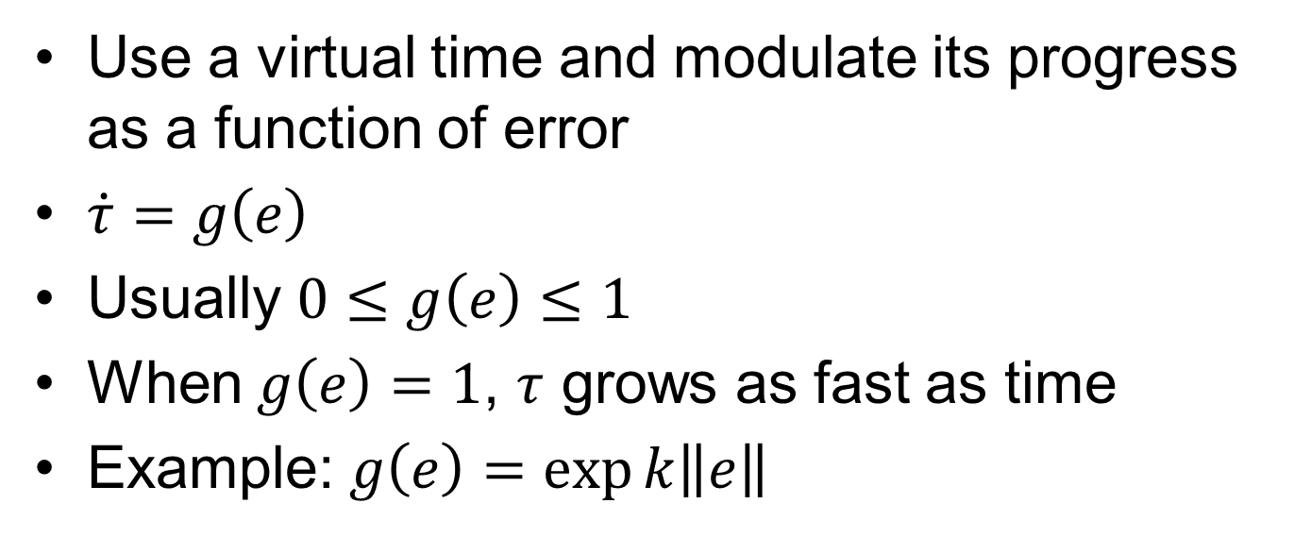
What if the robot cannot follow the target closely enough?
Use a virtual time and modulate its progress as a function of error
$\dot{τ}=g\left(e\right)$
Usually $0≤g\left(e\right)≤1$
When $g\left(e\right)=1$, $τ$ grows as fast as time
Example: $g\left(e\right)=\exp{k\left\|e\right\|}$

Slide 22
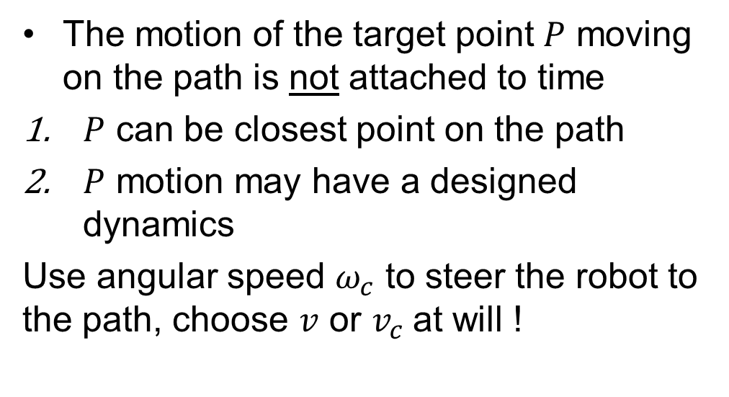
Path following
The motion of the target point $P$ moving on the path is not attached to time
$P$ can be closest point on the path
$P$ motion may have a designed dynamics
Use angular speed $ω_{c}$ to steer the robot to the path, choose $v$ or $v_{c}$at will !

Slide 23
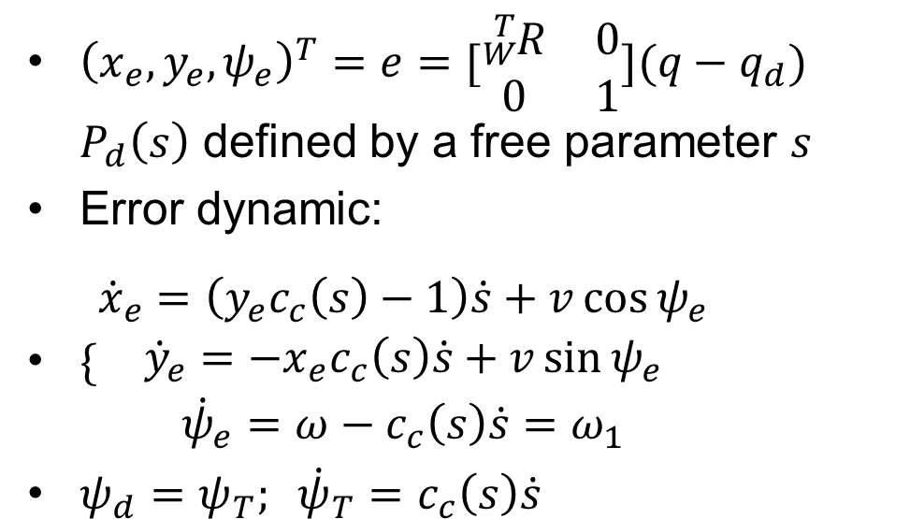
Path following, error dynamics
notice
${\left(x_{e},y_{e},ψ_{e}\right)}^{T}=e=[\begin{matrix}{}_{W}^{T}R & 0 \\ 0 & 1\end{matrix}](q−q_{d})$ $P_{d}\left(s\right)$ defined by a free parameter $s$
Error dynamic:
$\{\begin{matrix}{\dot{x}}_{e}=\left(y_{e}c_{c}\left(s\right)−1\right)\dot{s}+v\cos{ψ_{e}} \\ {\dot{y}}_{e}=−x_{e}c_{c}\left(s\right)\dot{s}+v\sin{ψ_{e}} \\ {\dot{ψ}}_{e}=ω−c_{c}\left(s\right)\dot{s}=ω_{1}\end{matrix}$
$ψ_{d}=ψ_{T}; {\dot{ψ}}_{T}=c_{c}\left(s\right)\dot{s}$

Slide 24
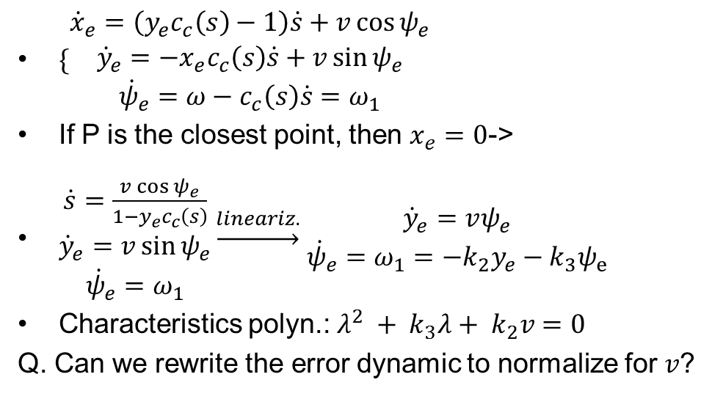
Error dynamics, P closest point
$\{\begin{matrix}{\dot{x}}_{e}=\left(y_{e}c_{c}\left(s\right)−1\right)\dot{s}+v\cos{ψ_{e}} \\ {\dot{y}}_{e}=−x_{e}c_{c}\left(s\right)\dot{s}+v\sin{ψ_{e}} \\ {\dot{ψ}}_{e}=ω−c_{c}\left(s\right)\dot{s}=ω_{1}\end{matrix}$
If P is the closest point, then $x_{e}=0$->
$\begin{matrix}\dot{s}=\frac{v\cos{ψ_{e}}}{1−y_{e}c_{c}\left(s\right)} \\ {\dot{y}}_{e}=v\sin{ψ_{e}} \\ {\dot{ψ}}_{e}=ω_{1}\end{matrix}\underset{→}{lineariz.}$ $\begin{matrix}{\dot{y}}_{e}=vψ_{e} \\ {\dot{ψ}}_{e}=ω_{1}=−k_{2}y_{e}−k_{3}ψ_{e}\end{matrix}$
Characteristics polyn.: $λ^{2} + k_{3}λ+ k_{2}v=0$
Q. Can we rewrite the error dynamic to normalize for $v$?

Slide 25
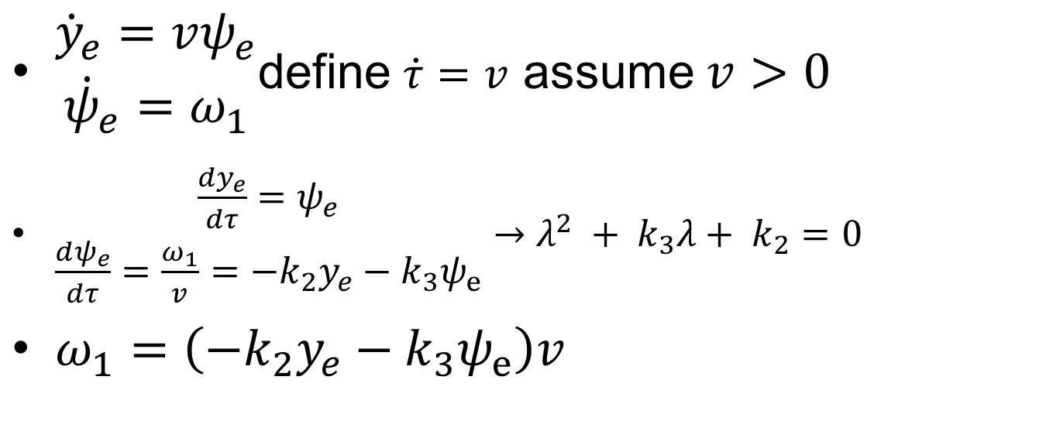
Derivatives w.r.t. Length time constant vs length constant !
$\begin{matrix}{\dot{y}}_{e}=vψ_{e} \\ {\dot{ψ}}_{e}=ω_{1}\end{matrix}$define $\dot{τ}=v$ assume $v>0$
$\begin{matrix}\frac{{dy}_{e}}{dτ}=ψ_{e} \\ \frac{dψ_{e}}{dτ}=\frac{ω_{1}}{v}=−k_{2}y_{e}−k_{3}ψ_{e}\end{matrix}→λ^{2} + k_{3}λ+ k_{2}=0$
$ω_{1}=\left(−k_{2}y_{e}−k_{3}ψ_{e}\right)v$

Slide 26
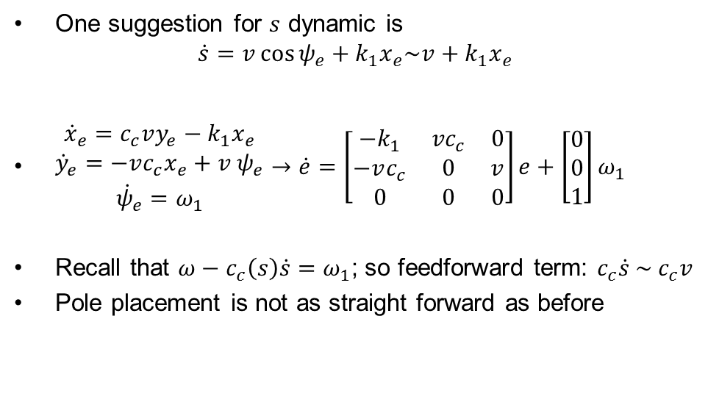
Error dynamics, P obeys given dynamics
One suggestion for $s$ dynamic is
$$\dot{s}=v\cos{ψ_{e}}+k_{1}x_{e}\sim v+k_{1}x_{e}$$
$\begin{matrix}{\dot{x}}_{e}=c_{c}vy_{e}−k_{1}x_{e} \\ {\dot{y}}_{e}=−vc_{c}x_{e}+v ψ_{e} \\ \begin{aligned}{\dot{ψ}}_{e}=ω_{1}\end{aligned}\end{matrix}→\dot{e}=\left[\begin{matrix}−k_{1} & {vc}_{c} & 0 \\ −vc_{c} & 0 & v \\ 0 & 0 & 0\end{matrix}\right]e+\left[\begin{matrix}0 \\ 0 \\ 1\end{matrix}\right]ω_{1}$
Recall that $ω−c_{c}\left(s\right)\dot{s}=ω_{1}$; so feedforward term: $c_{c}\dot{s} \sim { c}_{c}v$
Pole placement is not as straight forward as before

Slide 27
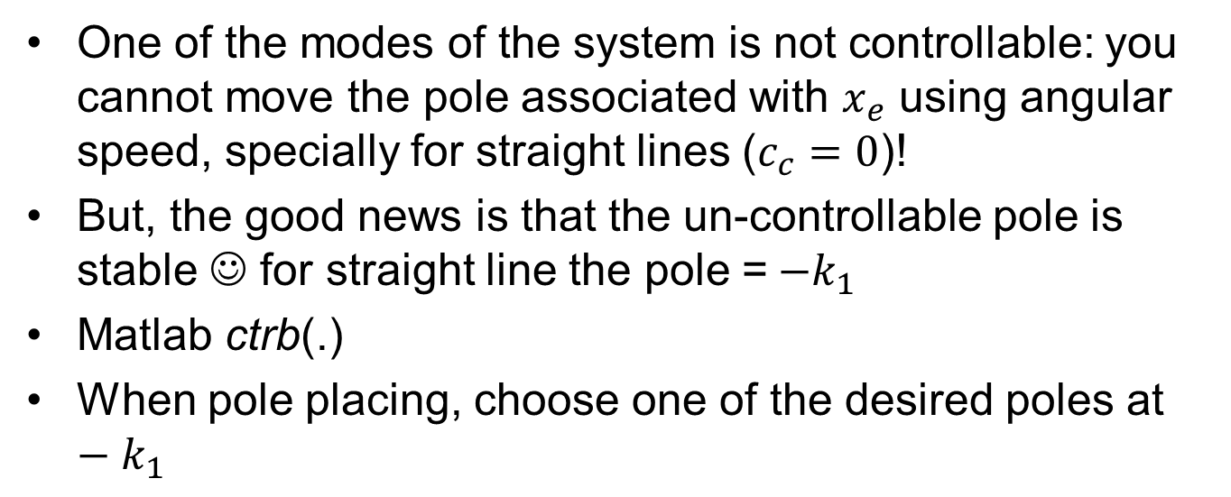
Controlability and pole placement
One of the modes of the system is not controllable: you cannot move the pole associated with $x_{e}$ using angular speed, specially for straight lines ($c_{c}=0$)!
But, the good news is that the un-controllable pole is stable ☺ for straight line the pole =$−k_{1}$
Matlab ctrb(.)
When pole placing, choose one of the desired poles at $−k_{1}$

Slide 28
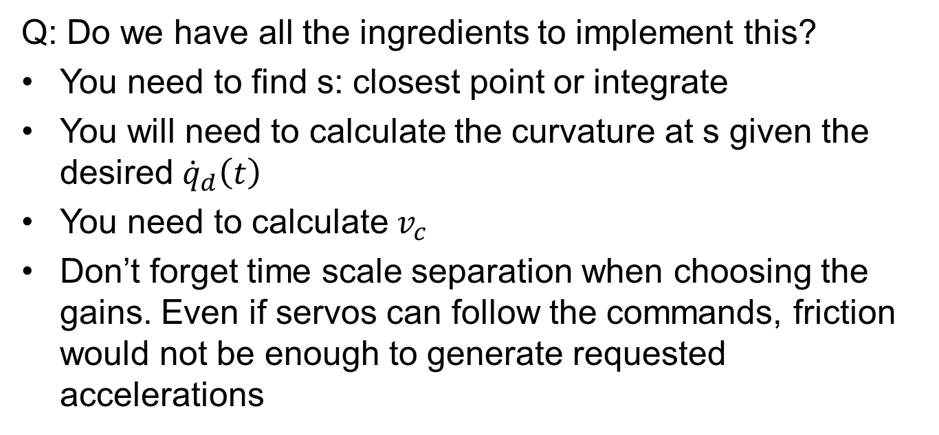
Implementation
Q: Do we have all the ingredients to implement this?
You need to find s: closest point or integrate
You will need to calculate the curvature at s given the desired ${\dot{q}}_{d}\left(t\right)$
You need to calculate $v_{c}$
Don’t forget time scale separation when choosing the gains. Even if servos can follow the commands, friction would not be enough to generate requested accelerations

Slide 29
Videos to see beforehand
Self study before the classes of week 44 and 45: selected video lectures from
ASE-7536, Model-Based Estimation
on Kalman filtering (w44) and Particle filtering (w45)

Slide 30
Videos to see beforehand
Video 1 part 1 and 2: good background if you want to refresh Bayes theory, mathematical articulation of random variables and probability (expectation, conditional probability, etc) and general problem of estimation
Video 3 (min 45): Hiden Markov Models and Linear Kalman Filter
Video 7 : Extended KF and other linear approximators
Video 8: Particle filter and Monte Carlo method

